Slide 1

Airport Valet Car Locator Mobile App
Jordan Treutel, Richard Hoehn, Ian Hurd, Patrick Burnett
December 6th, 2023

Slide 2
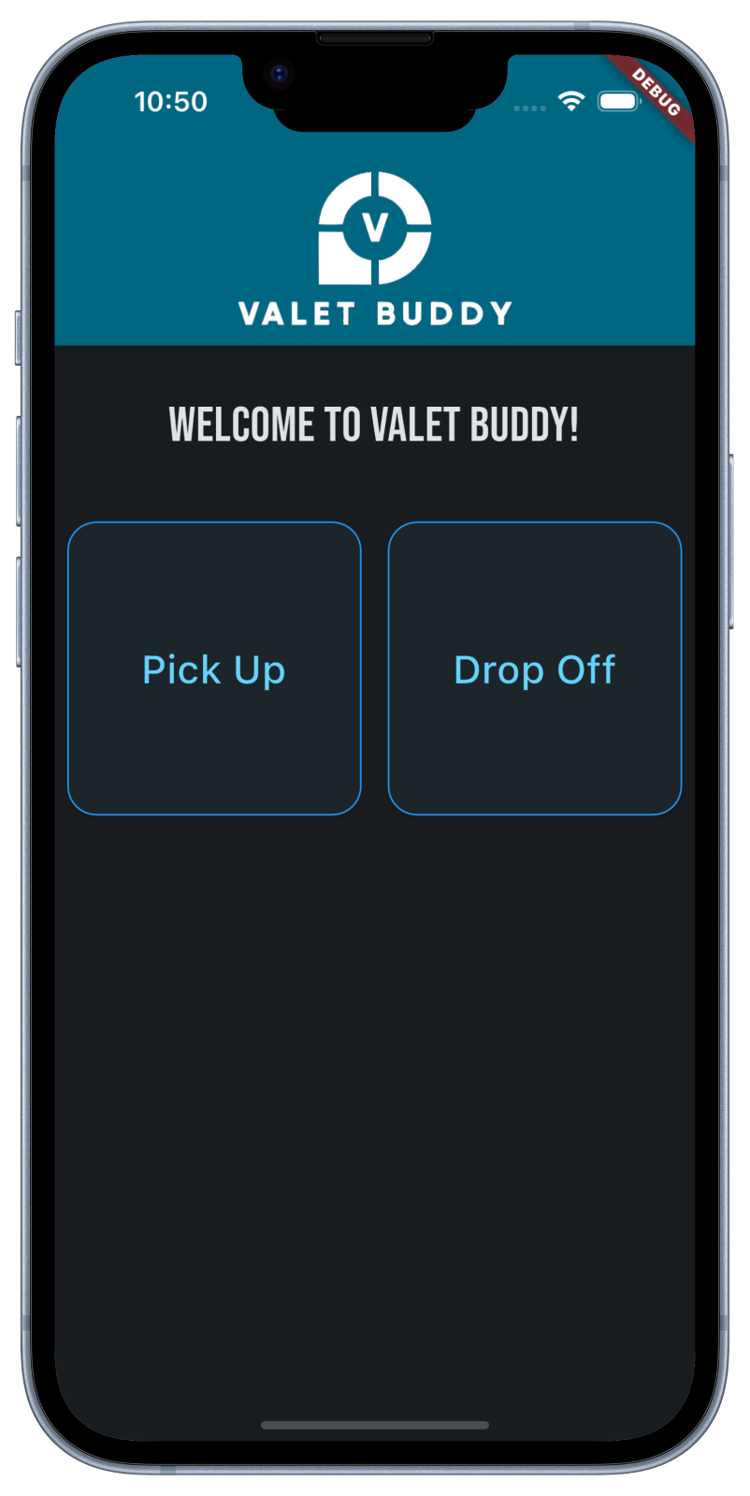


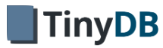
Introduction
RH
Mobile App for Valet Parking at Airports
App is solely used by the Valets
Business Case of App is Simple
GPS Location Tagging instead of parking field numbers
Scalable Parking Lots
No cost for painting numbers
Client / Server Architecture
Server – Python Flask Server with TinyDB as the datastore
Client – Flutter - iOS & Android Cross Platform Development

Slide 3

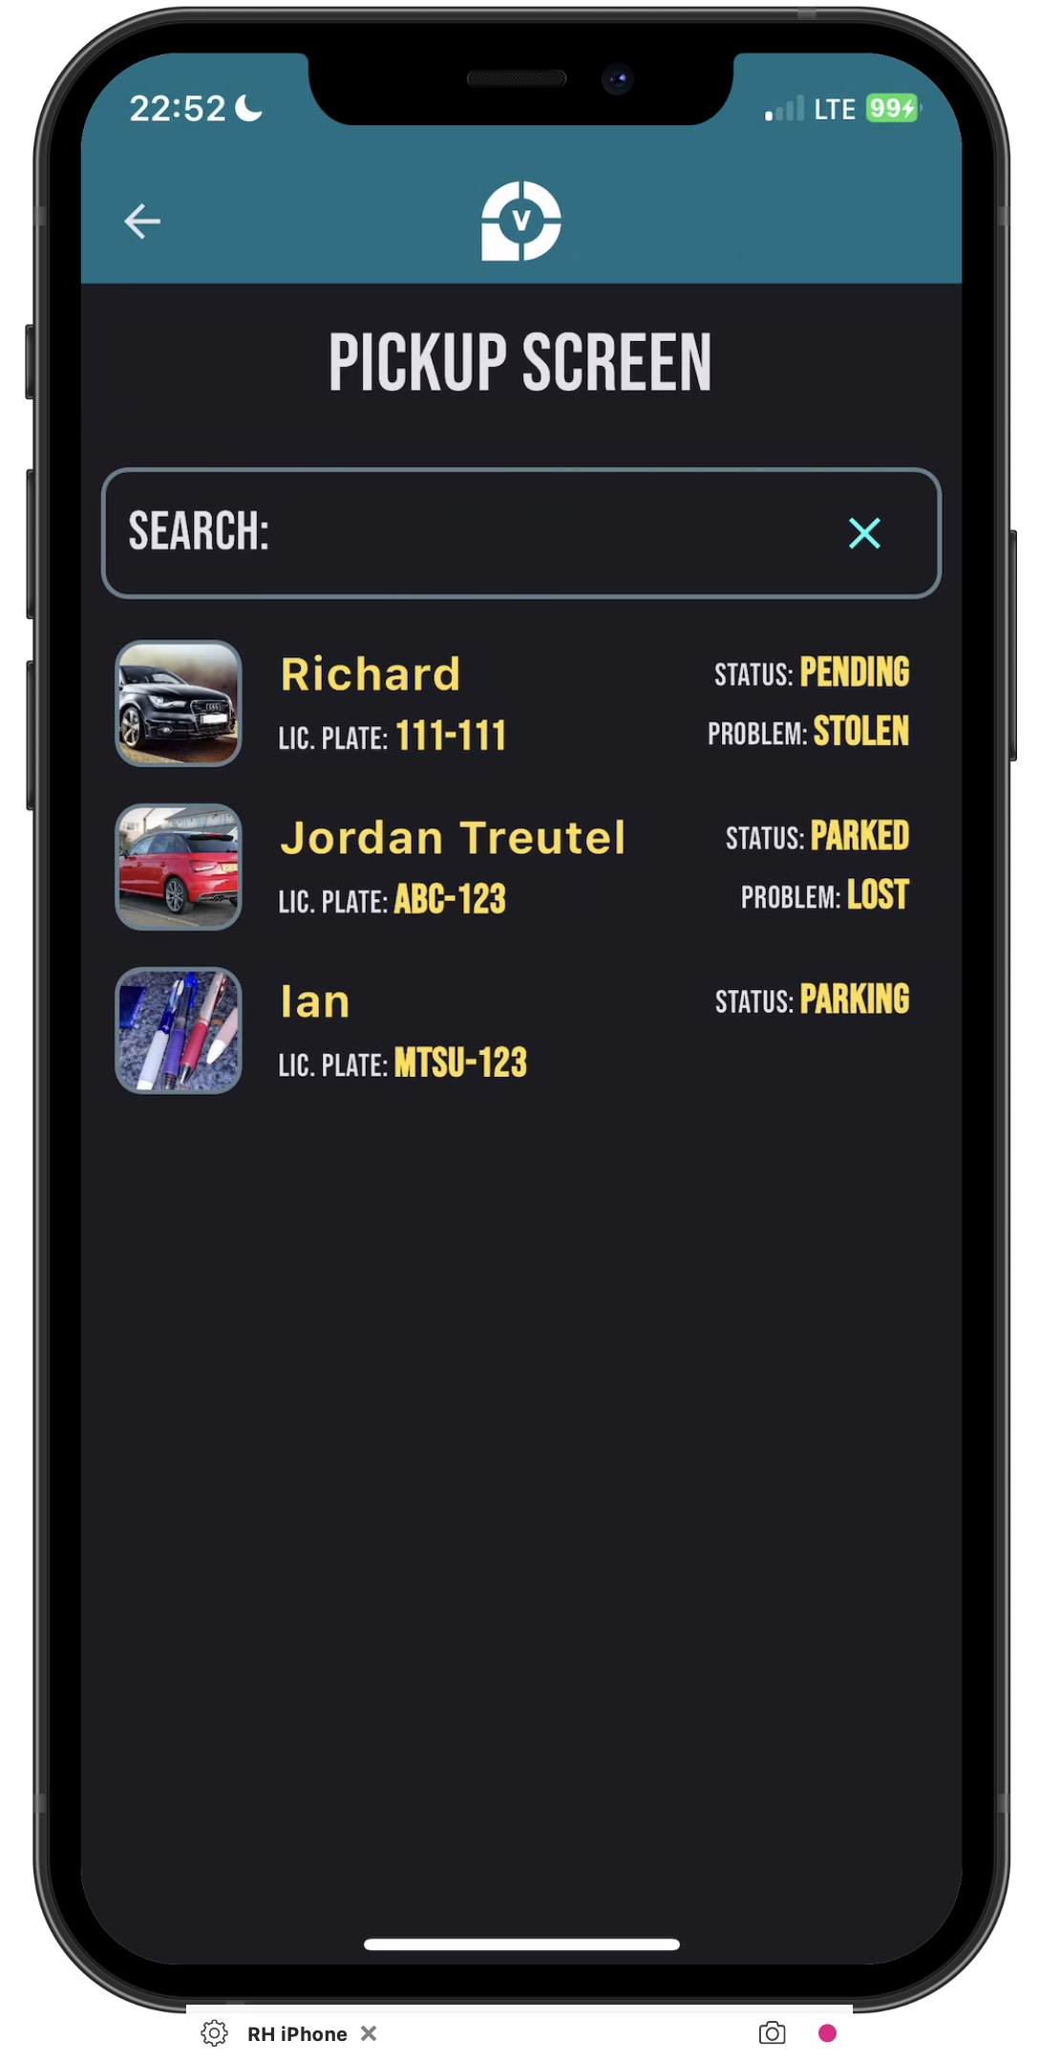
Problem Statement
RH
Using this app and GPS technology, the Airport Car parking owner will no longer have to physically paint numbers on parking spaces anymore!
Which Saves:
Time
Money
and Improves Scalability of expanding to more Parking Lots
It allows to faster find the cars and move them around.
Plus enabling taking pictures allows for quicker retrieval

Slide 4
Project Scope & Stakeholders/Users
RH
App
Input the car's license plate number
Upload a picture of their car to the app
Save GPS coordinates of a car's location
Access / Filter list of cars and select one to retrieve
Report problems with cars (Lost, Stolen, Scratch)
Server
RESTful API
JSON
Flask with TinyDB as database
Airport administration
Valets (drivers) - main users of the app
Airport travelers (car owners)
Owner of airport parking lot
Business and financial staff at Valet Buddy company

Slide 5
Project Scope (cont.) (Non Functional Requirements)
RH
In Scope
Out of Scope
JSON for data transfer
Flutter - mobile framework
Dart – mobile programming language
Google Maps API
Python
Flask (REST)
Database – TinyDB (native python)
Image Capture in JPEG
All communications done via 'https'
Backing up database and car images to AWS S3 on a daily basis
For demo, will store files on server – Usually this would be in AWS S3
Monetization
Email Weekly map (PDF) of all location of the cars
User Registration & Mgmt.

Slide 6
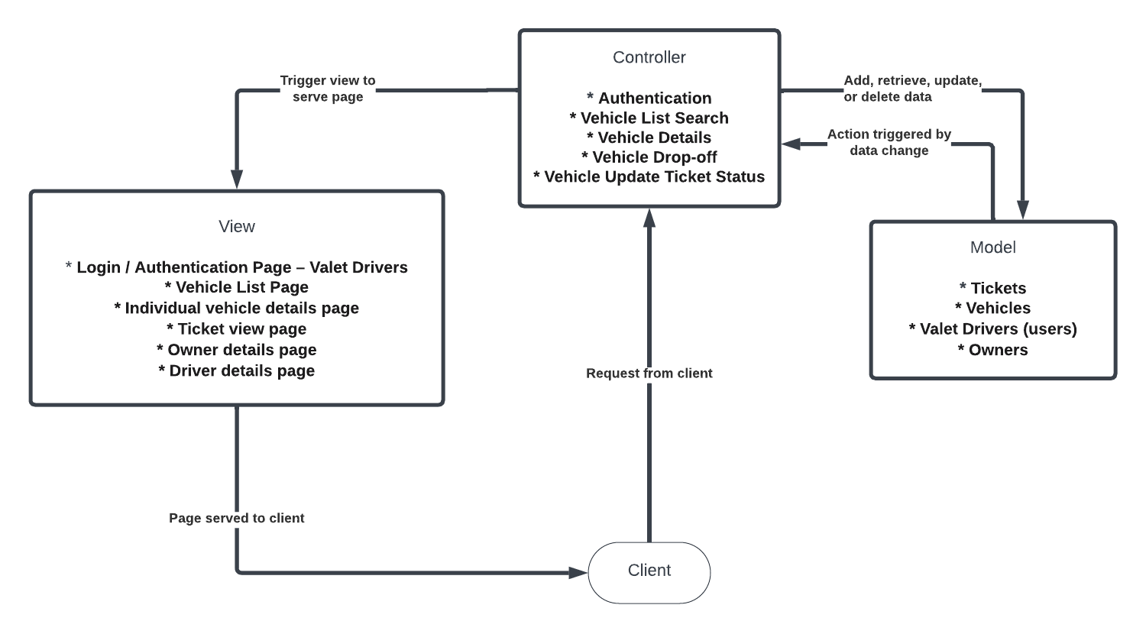
Initial Design Architecture - MVC
PB

Slide 7
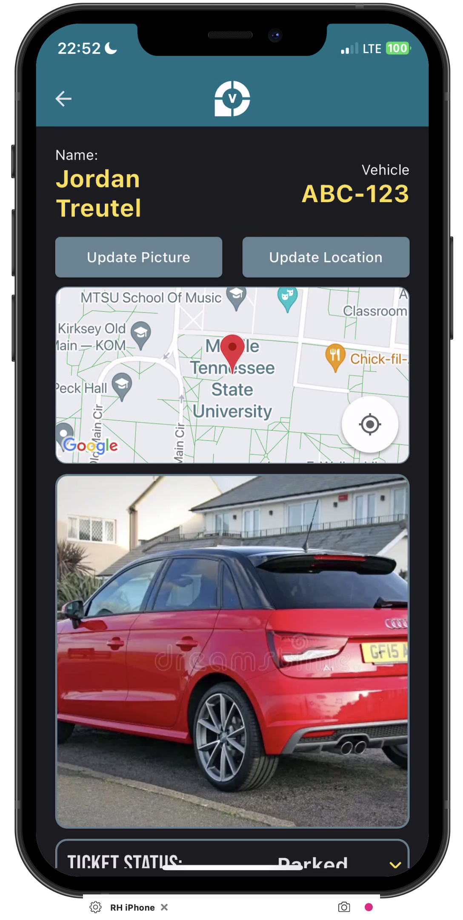
Implementation: MVC and Flask
PB
Despite the initial plan being model-view-controller framework for the application, the actual implementation only made use of models and views, with views filling the role of what would otherwise be the controllers' job.
Presentation is handled by client-side Flutter framework

Slide 8
Key Object-Oriented Principles
JT
Inheritance (Flutter)
Widget inheritance is one of the design patterns in Flutter.
Most all UI frameworks (flutter, angular, react) use inheritance to manage the UI state.
Composition
In Flutter we regularly use composition, in that a widget (Expl: Container) is passed a "child" widget of type TextBox() - This means that the Container is composable.
Encapsulation
Our Valet Buddy app is heavily reliant on encapsulation. This can be observed by our class diagram implementing methods that only that class can perform.
This is important since it places restrictions on accessing methods directly and prevents accidental modification of data and states of the Tickets.

Slide 9
OO Principles & Modular Code
JT
Code Reusability
Ticket, TicketStatus, ProblemType classes
Maintainability (changing one part of code doesn't mess with unrelated functionality)
Config file for changing global values across the app (IP, port, host name, color themes, and other constants)
Readability (organized and easy to compartmentalize in your head)
Custom Widgets used to build screens

Slide 10
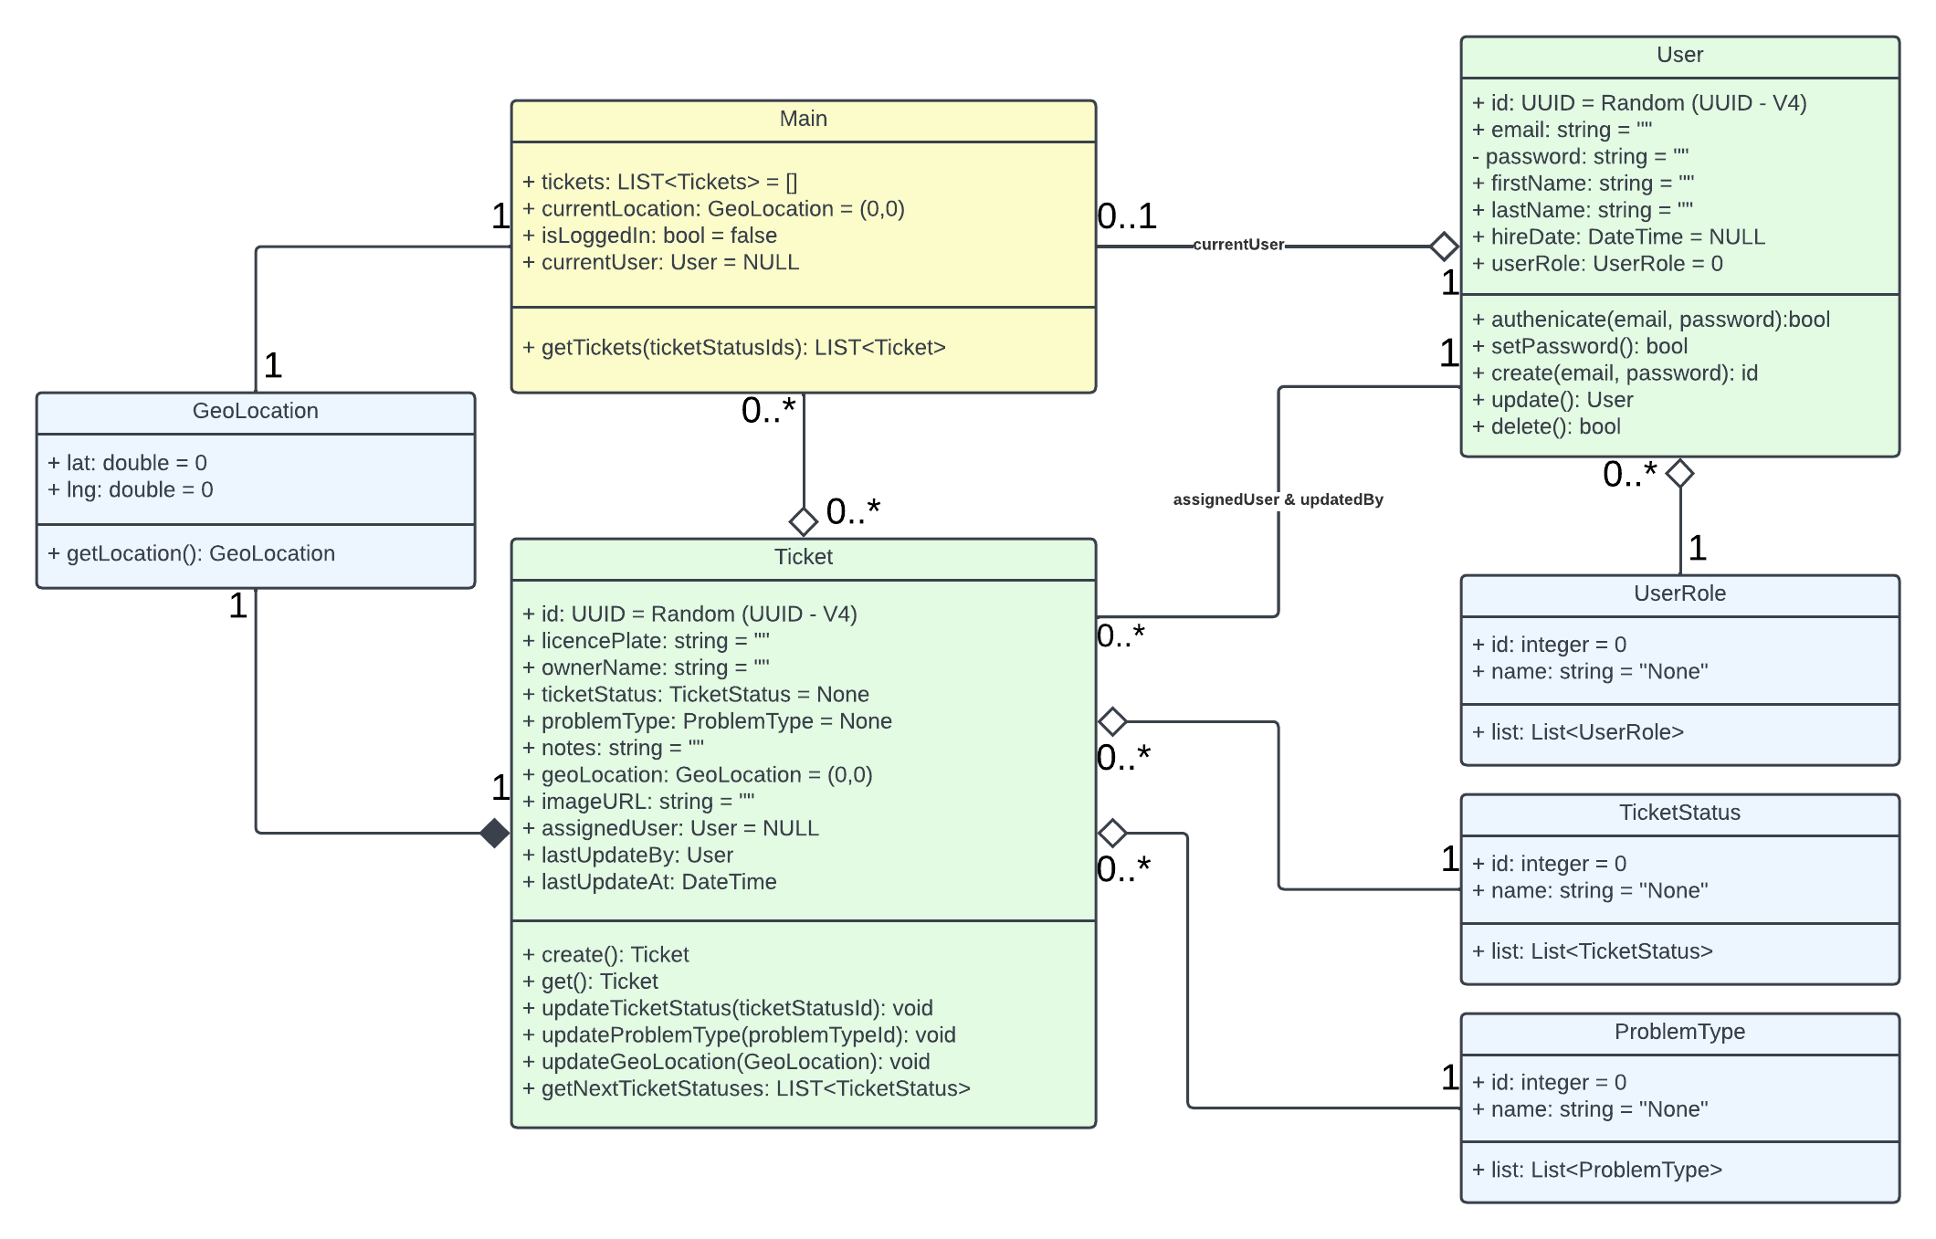
Class Diagram - App
IH

Slide 11
Design Takeaways
JT
Adding or modifying any project or feature can grow in complexity very quickly
Expl: Ticket Status + Problem Types etc...
Design Architecture of choice = foundation for development
Class Diagrams = transition from design to implementation
Lots of time spent on defining the methods
Challenges:
Fitting Design Architecture to MVC
Do model and view directly communicate?
Valet drivers send requests directly to controller, not the view
Deciding relationships between classes
Mobile App vs. Server might require two different Architectures

Slide 12
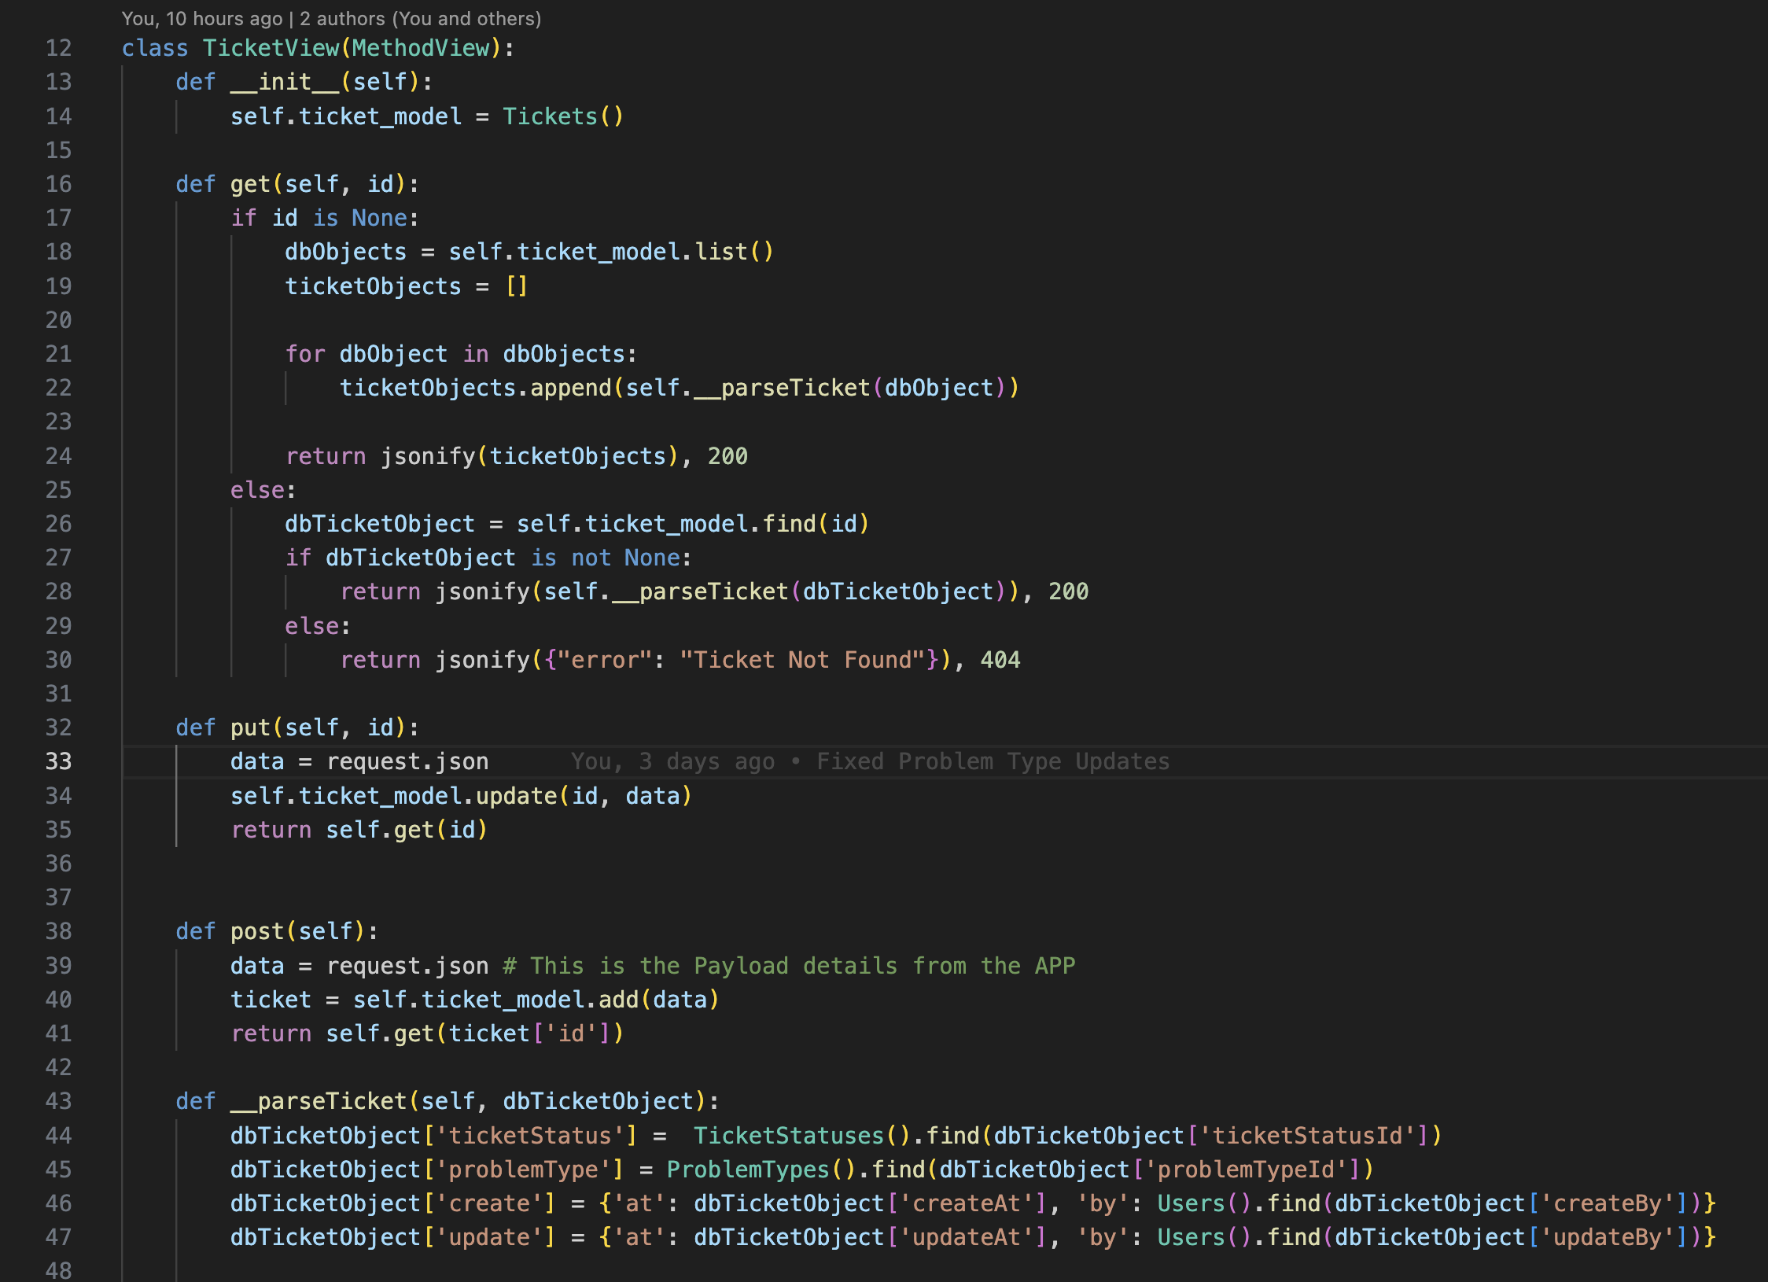
Server Implementation – Ticket View
IH
Get request for ticket is passed ticket ID and retrieves ticket.
Certain fields receive additional formatting before output
Lack of ID passed to get returns list of all tickets
POST and PUT create and update tickets respectively

Slide 13
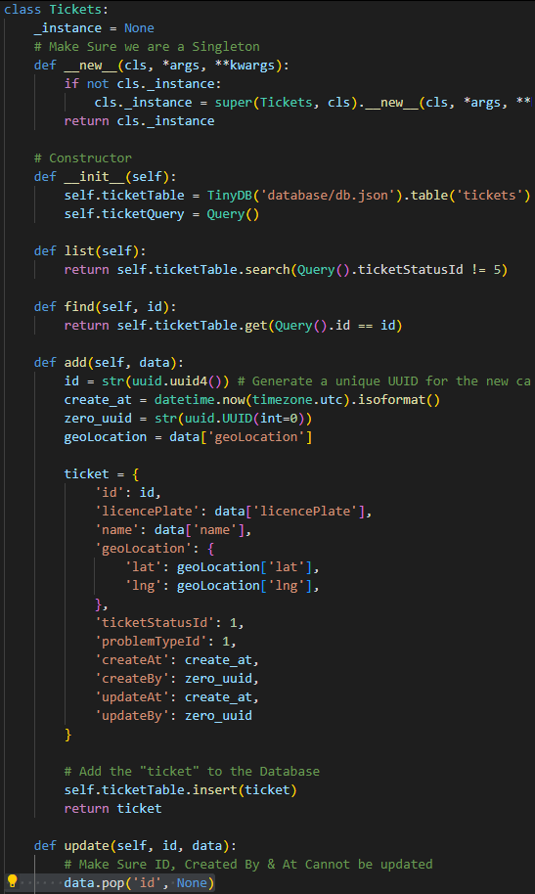
Server Implementation – Ticket Model
IH
Model handling direct database access for ticket retrieval and manipulation
Contains methods for creating, modifying, searching, and listing tickets
Important to know is that the Model – Is a singleton – since it interfaces with the Database.

Slide 14
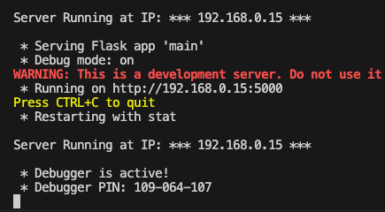
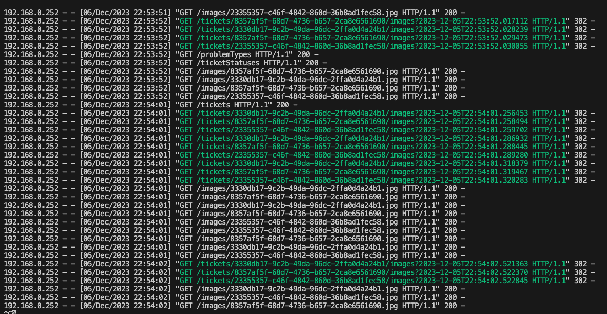
Server Implementation – User Model and View
IH
Similar to ticket model and view
GET finds specific instance or lists them all, as with tickets
Lacks PUT method
User authenticated with POST
Users hardcoded for development; software interface for user registration out of scope for project

Slide 15
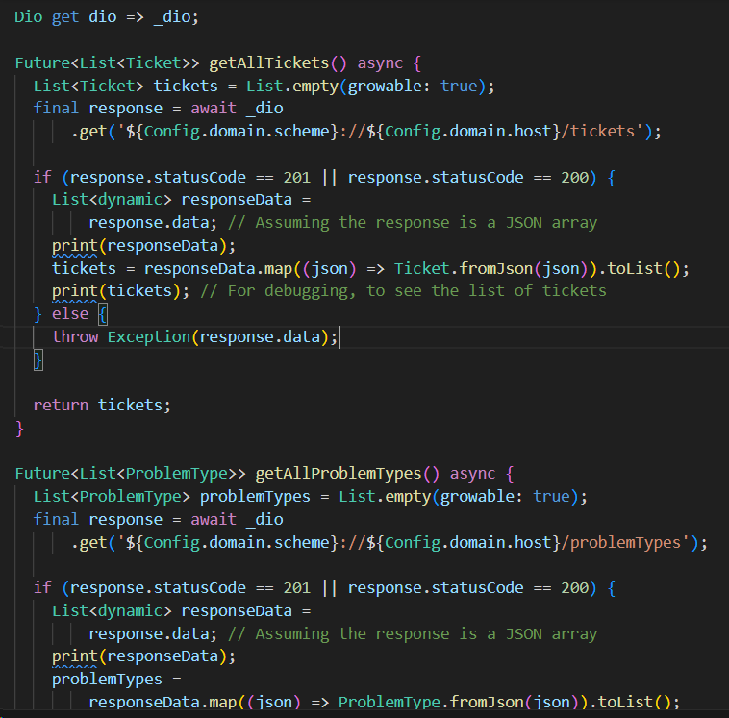
Client Implementation – App <-> Server Interface
JT
Establishes a single Dio connection to the server (HTTP networking package for Dart/Flutter)
Each method defined allows for the client/app to interact with the server
Example: getAllTickets() returns all of the tickets so they can be displayed on the Pick-Up Screen
Retrieving data from the server:
Uses dio to pull from the /tickets endpoint
Waits for a response code of 201 or 200
Maps each ticket to a Ticket object
Returns a list of all Tickets
Updating server done through the Ticket class itself (next slide)

Slide 16
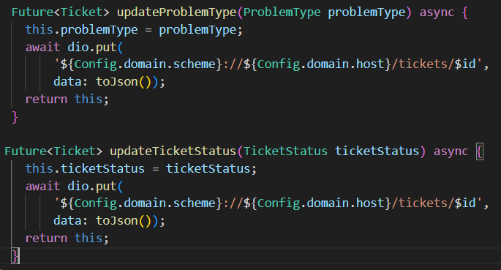
Client Implementation – Ticket Class
JT
Contains several attributes that comprise any Ticket:
Geolocation, id, licensePlate, name, problemType, ticketStatus, updatedBy
Also contains methods that can update the server:
Directly update the server from inside the actual Ticket itself
Example: updateProblemType(problemType) will update the server to reflect the new problemType for this Ticket instance.
Can also map a Ticket's Dart representation to or from JSON (so it can be stored/retrieved from the TinyDB on the server)

Slide 17
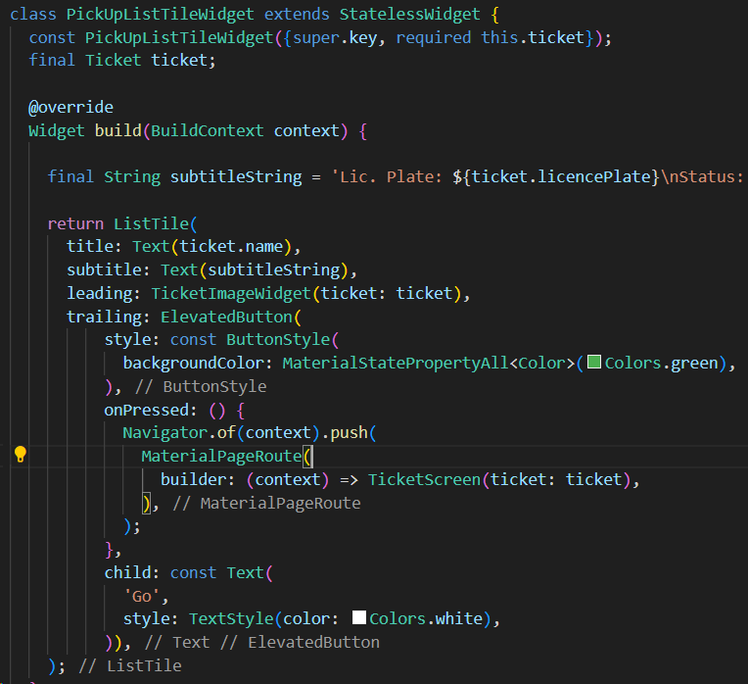
Client Implementation – Custom Widgets & Screens
JT
Stateful: A widget or screen that stores variable data that is used to build or rebuild the UI at any moment in time​
Stateless: A widget or screen that has no mutable state that needs to be updated; the UI does not dynamically update​
Stateful widgets/screens in our app often store a specific Ticket or a List<Ticket> relevant to that screen​
Ex: Pick-Up Screen contains state that stores a list of all tickets for displaying.
The screen itself is built using a hierarchical structure of widgets (both custom and built-in)

Slide 18
Results & Achievements
PB
Successfully implemented planned design
Working app that can connect to back end server
Able to use Google Maps API

Slide 19
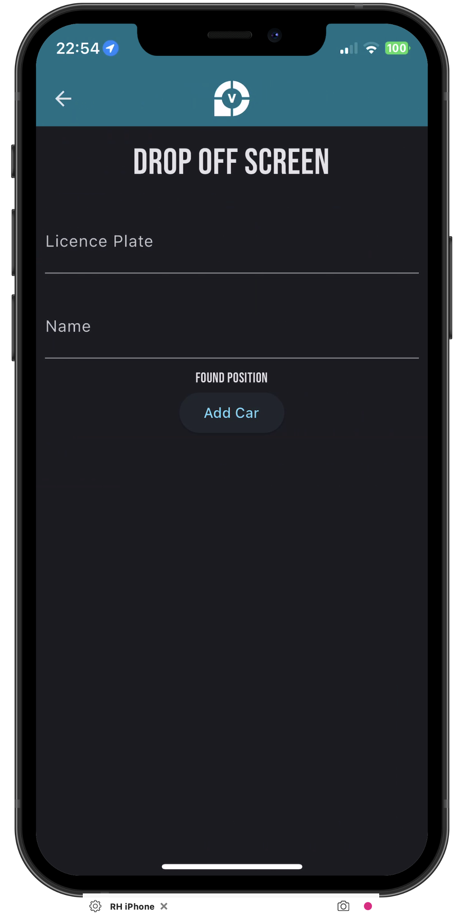
Challenges
RH
Data type int/str issues during server/client interactions
GPS location (by use of simulated or virtualized devices)
Transitioning from MVC design plan to View/Model architecture
Creating separate architectures for App and Server

Slide 20
Future Improvements
PB
Daily database backups
Switch from locally hosted server to cloud server
Create map of all car locations
Have all communications done via 'https'

Slide 21
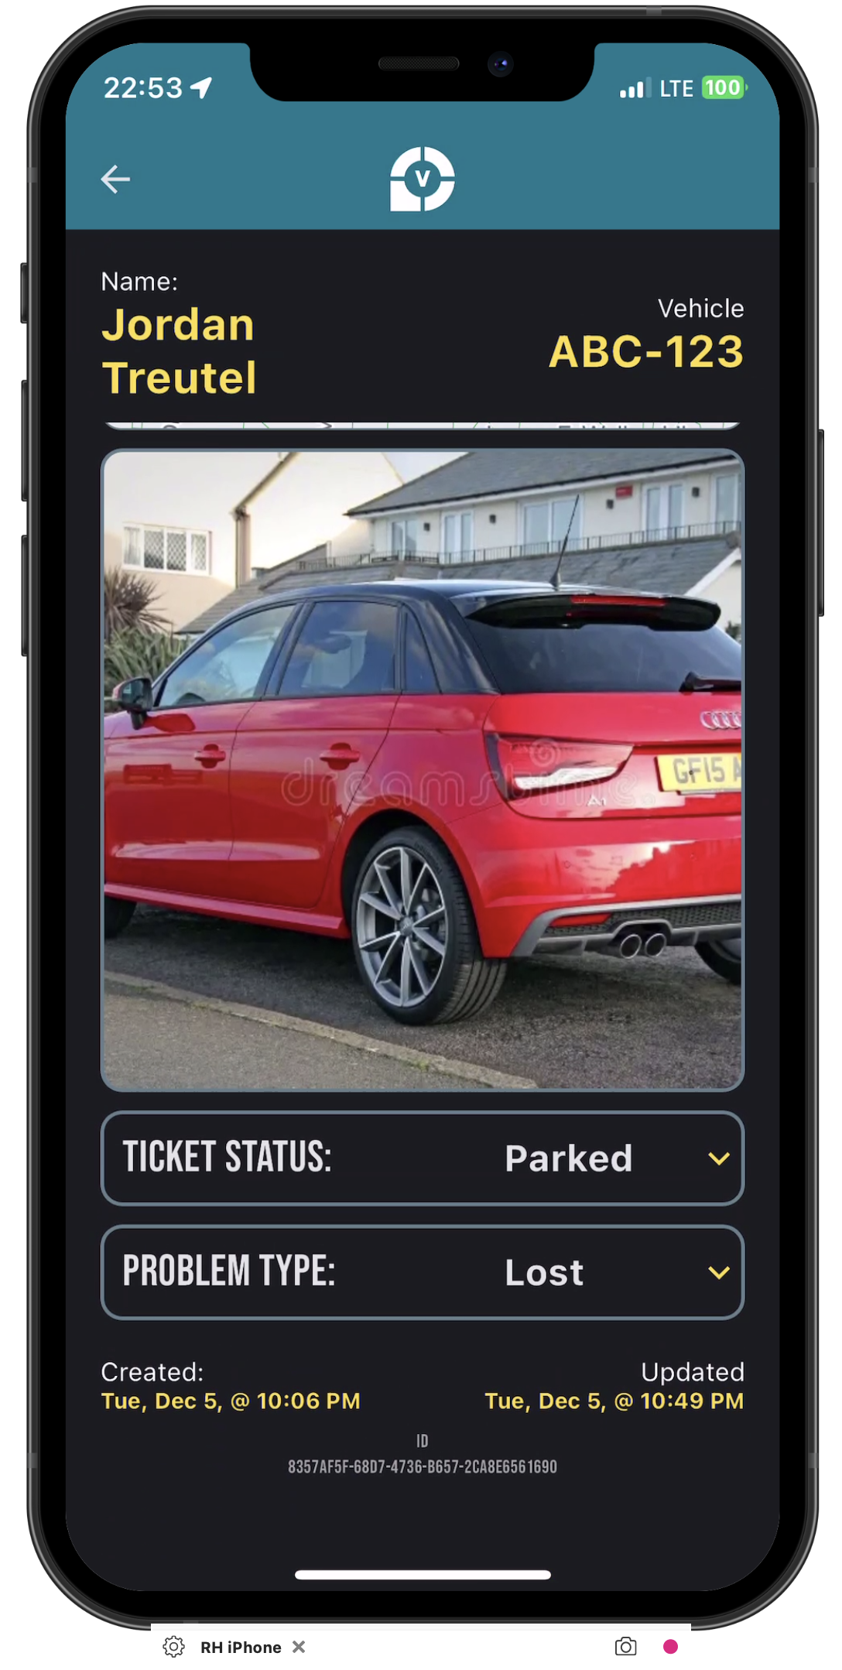
Conclusion
PB
Initial MVC architecture as a jumping off point
Extensively planning out classes and relations helped identify errors and points of confusion before any code was written

Slide 22
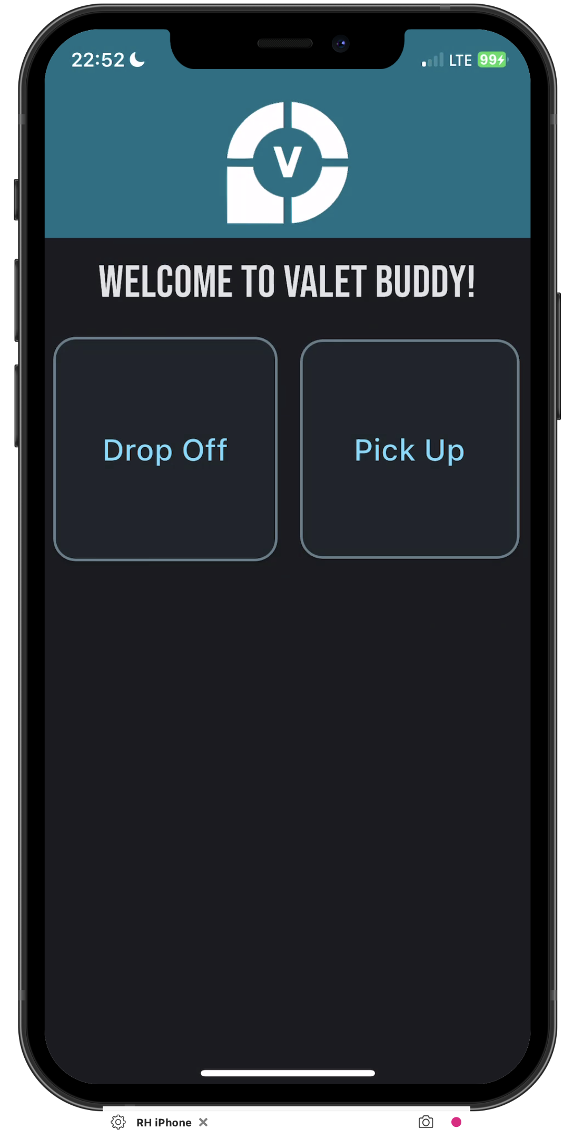
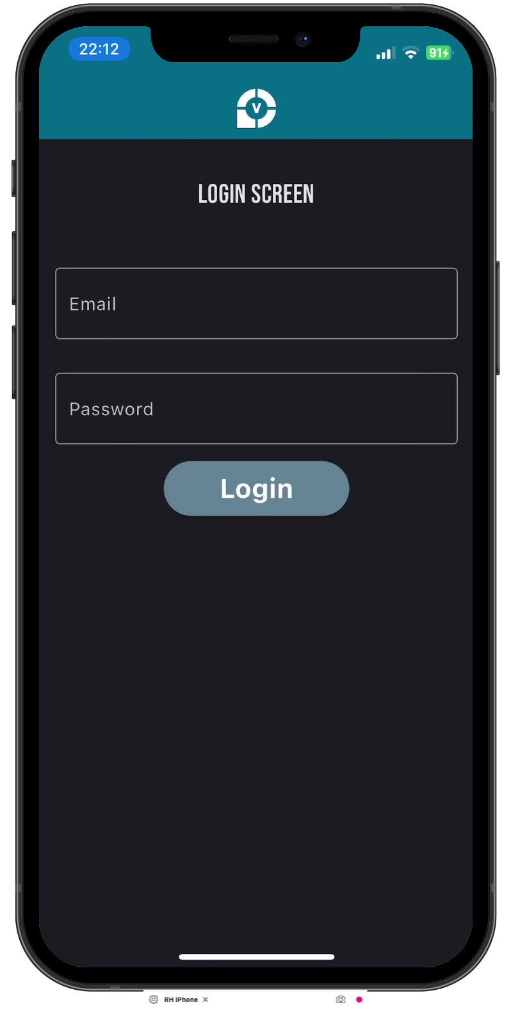
App Demo
RH

Slide 23
Questions?

